Slide 1
Simulation of a complex gas system
Aleksey Podkidyshev
Moscow Institute of Physics and Technology 2020

Slide 2
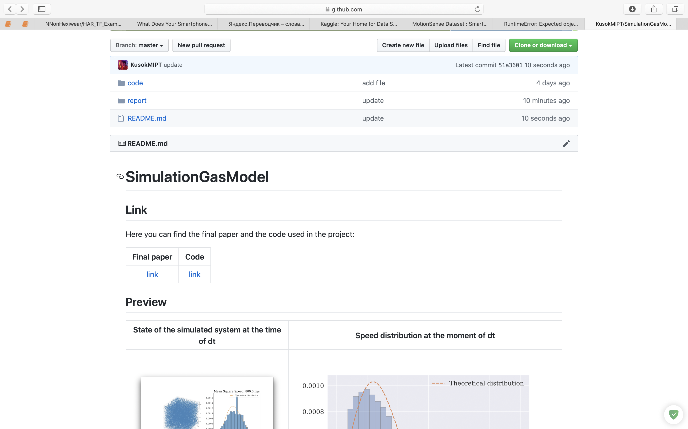
Reference
shorturl.at/kFOQV

Slide 3
Description

Slide 4
Research Goal
Establish the relationship between macro and micro-parameters.
Test Ideal gas law.
Test speed distribution and compare with Maxwell distribution.
Estimate the pressure fluctuation. Compare with theoretical assumptions.
Simulate the heat machine cycle.

Slide 5
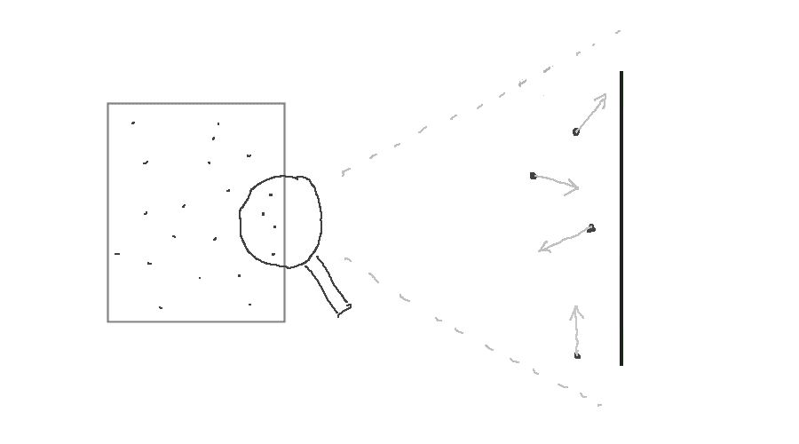
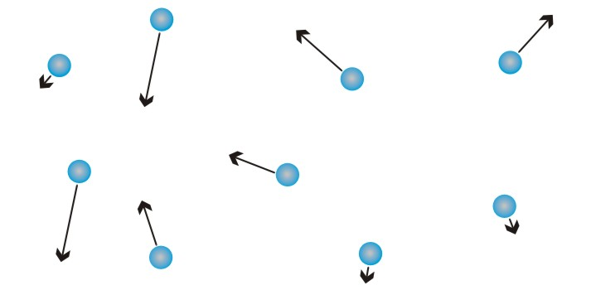
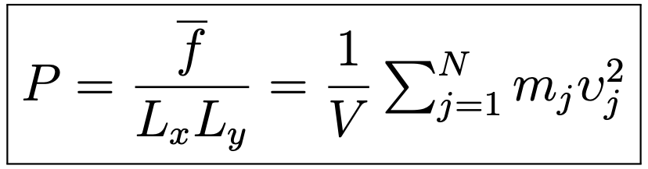
Theoretical description of the model
Description of the molecules collision
Description of the molecules collision with walls

Slide 6
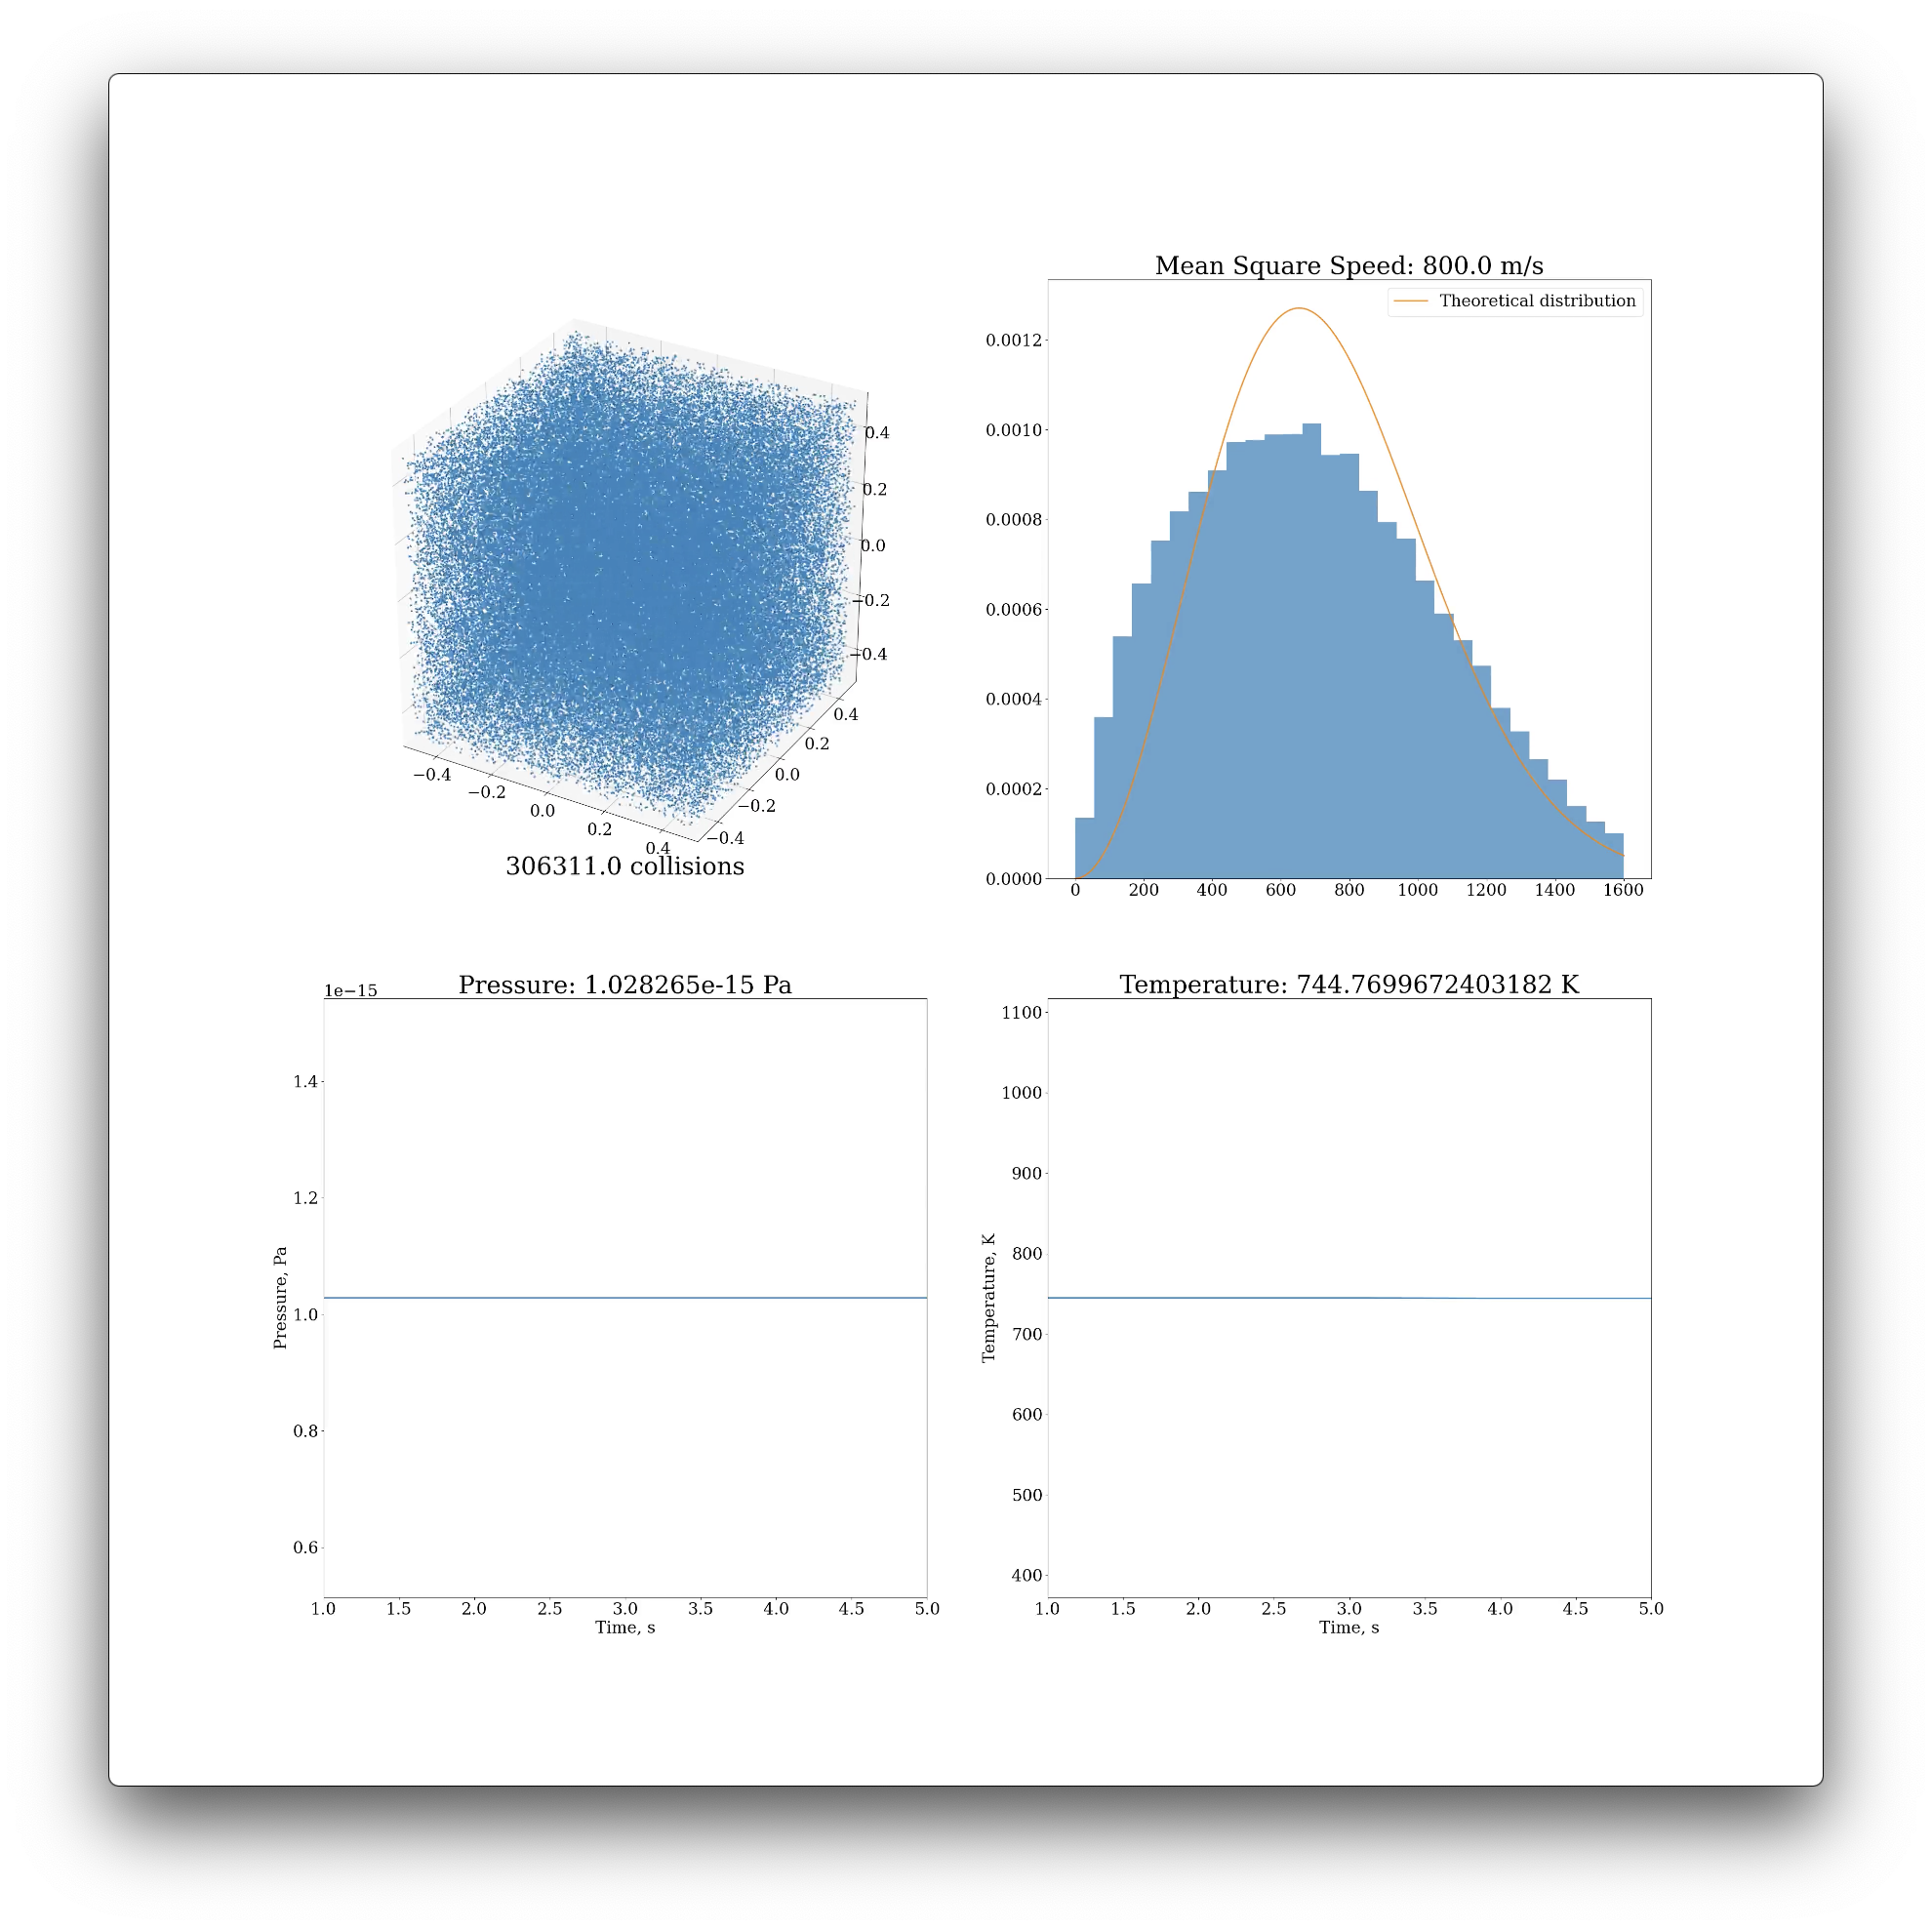
Software Architecture: Video

Slide 7
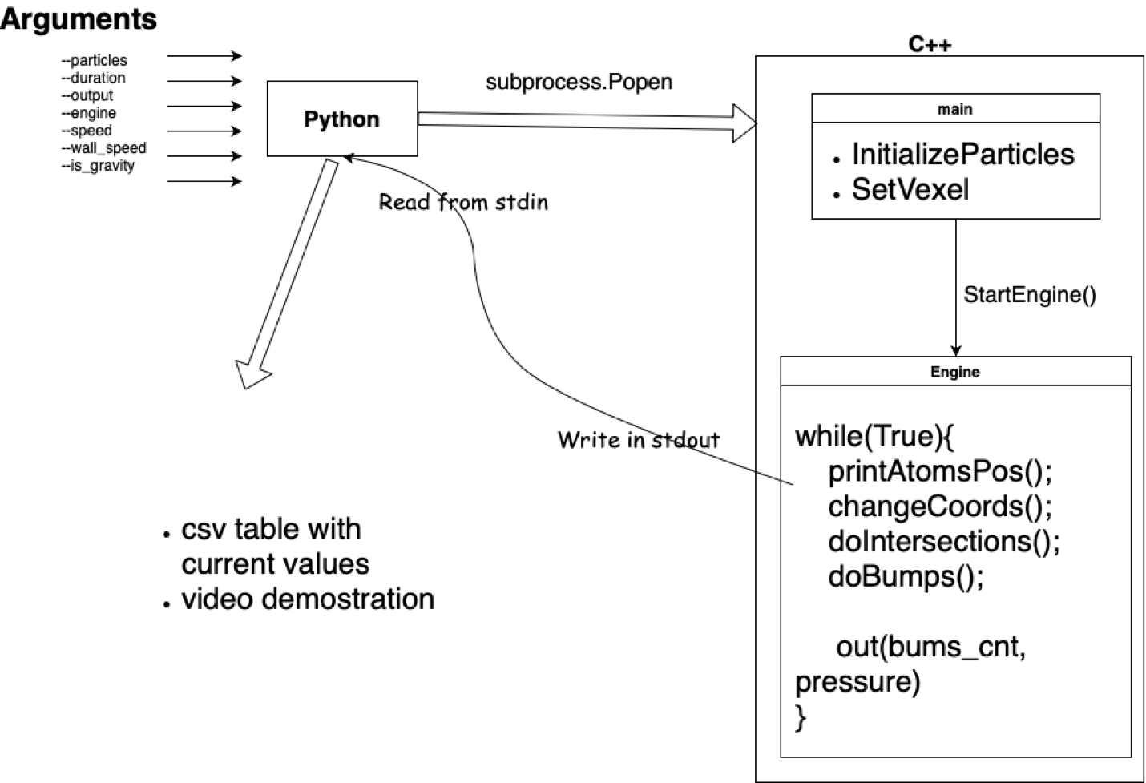
Architecture
g++ -O3 -o simulation -Wno-write-strings -std=c++17 main.cpp
python3 render.py –engine simulation –particles 1000 –duration 10

Slide 8
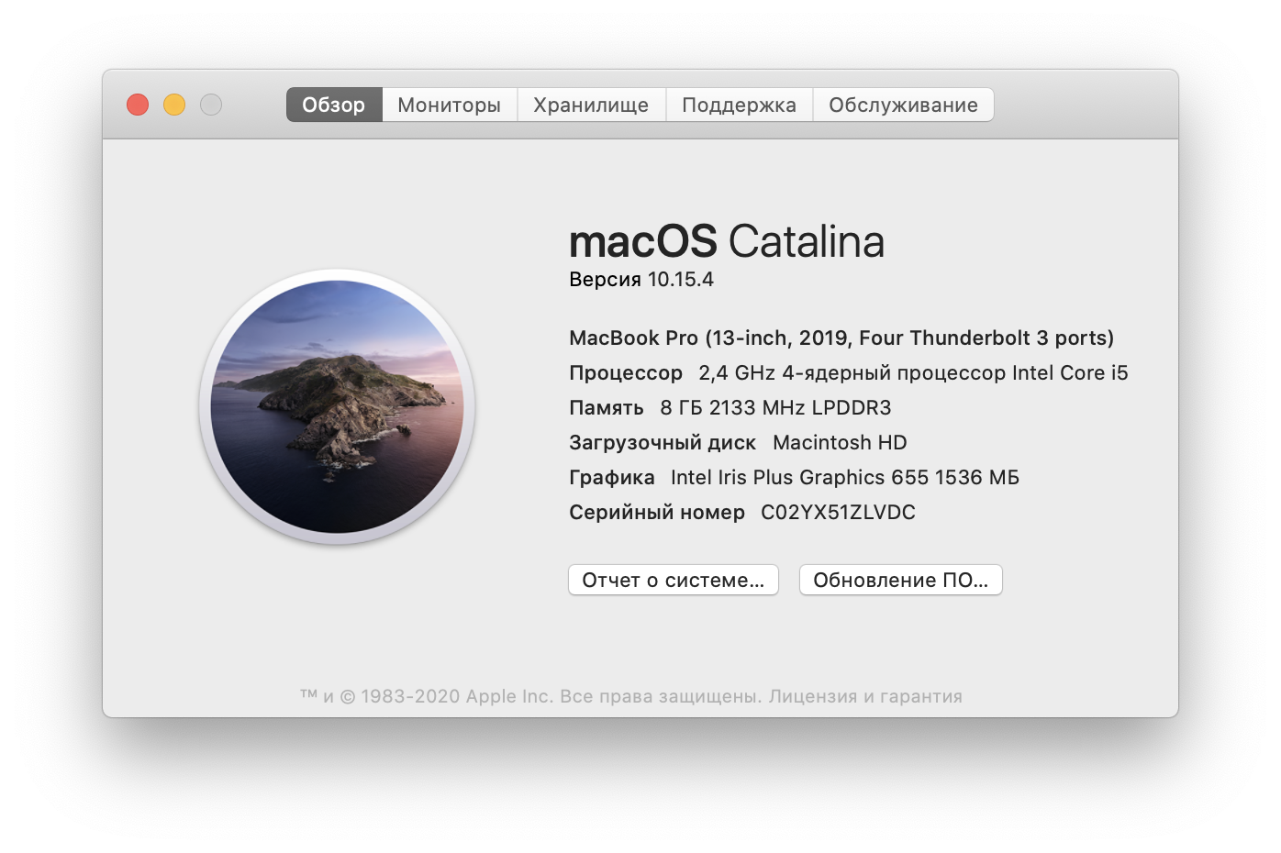

Machine
Yandex Compute Cloud
Macbook Pro 2019 13inch

Slide 9
Execution time

Slide 10
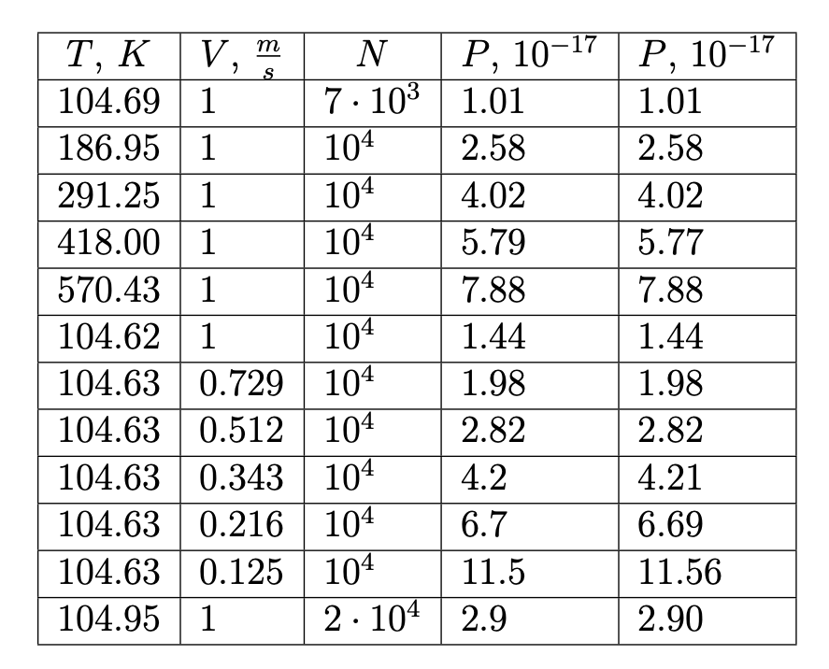
Results: Ideal gas law
𝑃𝑉 = 𝜈𝑅𝑇

Slide 11
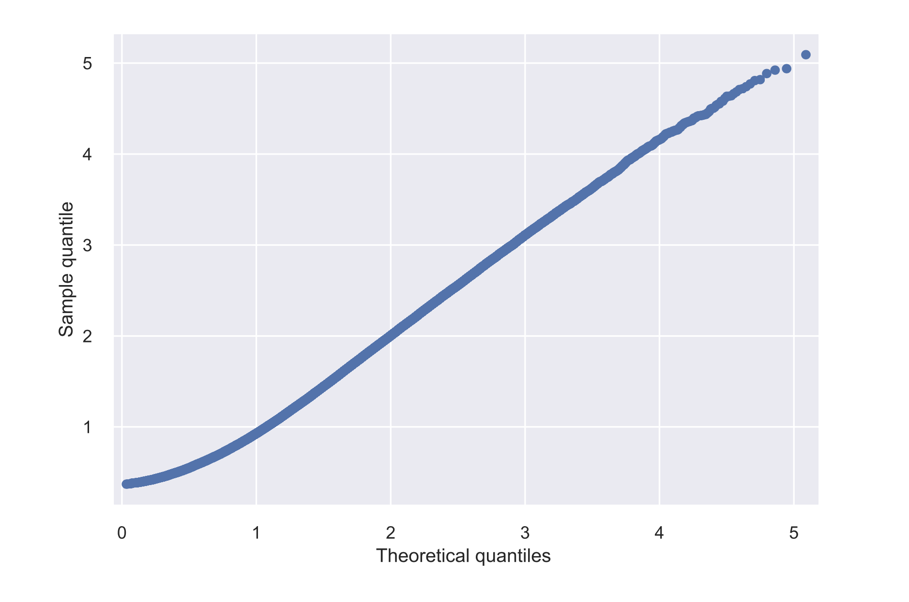
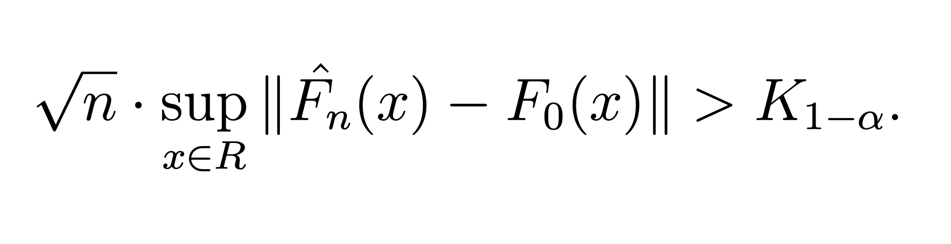
Results: Speed distribution

Slide 12
Results: Pressure fluctuations, Energy distribution
https://www.lapasserelle.com/statistical_mechanics/lesson_5.pdf

Slide 13
Results: Heat machine cycle
Process:
- Adiabatic compression
- Isochoric cooling
- Isothermal expansion
- Isochoric heating

Slide 14
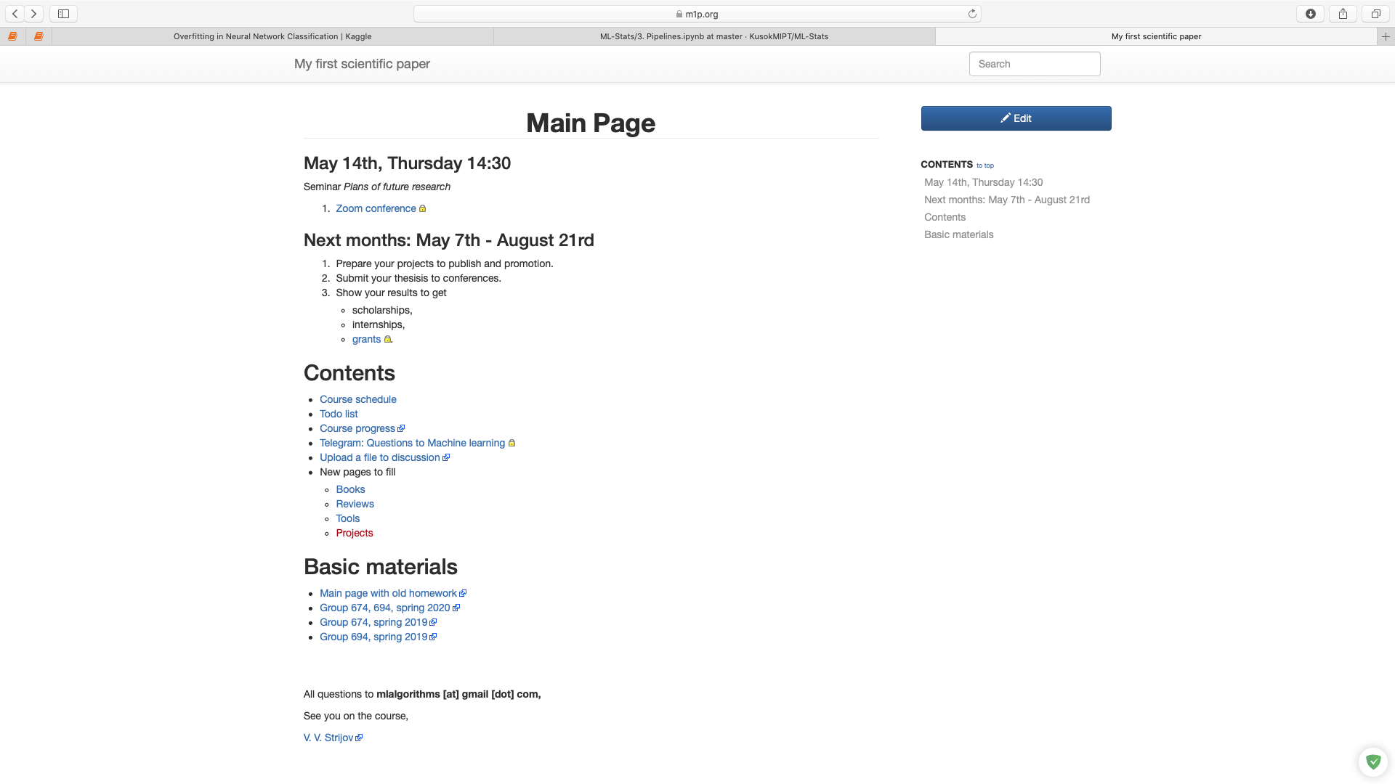
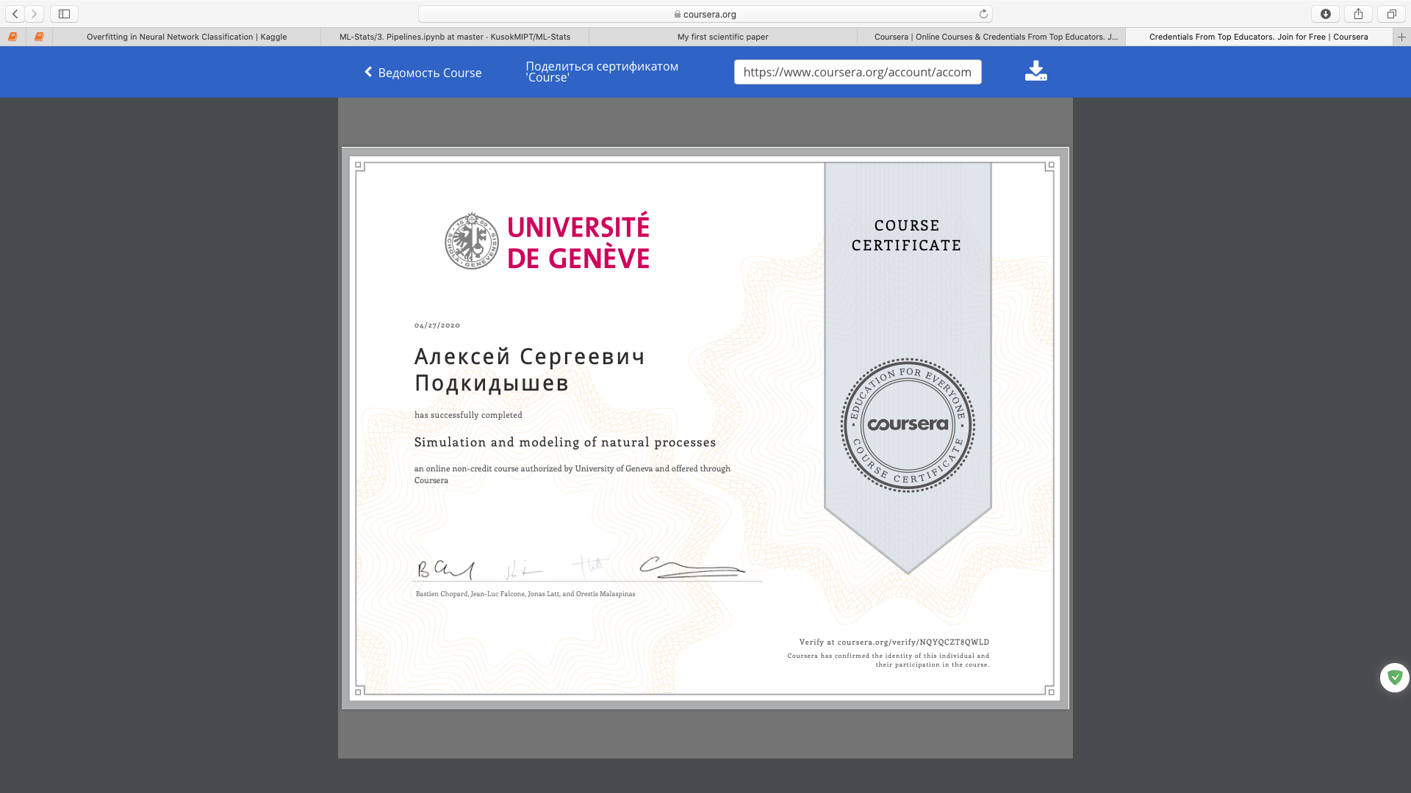
Interesting resources
My first scientific paper
Simulation and modeling of natural processes

Slide 15
Conclusion
Prove Ideal gas law
Prove speed distributions
Test pressure fluctuations
Simulate cycle of the heat machine
Model seems to be convincing

